Slide 2
UNIT 1
INTRODUCTION , HTML & CSS

Slide 3
REFERENCE MATERIAL
Robert W. Sebesta (2015), Programming The World Wide Web, Eighth Edition, Pearson
Chapter 1,2, 3

Slide 4
INTRODUCTION

Slide 5
Internet History
What the Internet is:
A world-wide network of computer networks
At the lowest level, since 1982, all connections use TCP/IP
TCP/IP hides the differences among devices connected to the Internet

Slide 6
Internet Protocols
Internet Protocol (IP) Addresses
Every node has a unique numeric address
Form: 32-bit binary number
New standard, IPv6, has 128 bits (1998)
Organizations are assigned groups of IPs for their computers
Problem: By the mid-1980s, several different protocols had been invented and were being used on the Internet, all with different user interfaces (Telnet, FTP, Usenet, mailto

Slide 7
Internet Protocols
Domain names
Form: host-name.domain-names
First domain is the smallest; last is the largest
Last domain specifies the type of organization
Fully qualified domain name - the host name and all of the domain names
DNS servers - convert fully qualified domain names to IPs

Slide 8
Client and Server
Clients and Servers are programs that communicate with each other over the Internet
A Server runs continuously, waiting to be contacted by a Client
Each Server provides certain services
Services include providing web pages
A Client will send a message to a Server requesting the service provided by that server
The client will usually provide some information, parameters, with the request

Slide 9
The World-Wide Web
A possible solution to the proliferation of different protocols being used on the Internet
Origins
Tim Berners-Lee at CERN proposed the Web in 1989
Purpose: to allow scientists to have access to many databases of scientific work through their own computers
Document form: hypertext
Pages? Documents? Resources?
We’ll call them documents
Hypermedia – more than just text – images, sound, etc.

Slide 10
The World-Wide Web
Web or Internet?
The Web uses one of the protocols, http, that runs on the Internet--there are several others (telnet, mailto, etc.)

Slide 11
Web Browsers
Browsers are clients - always initiate, servers react (although sometimes servers require responses)
Mosaic - NCSA (Univ. of Illinois), in early 1993
First to use a GUI, led to explosion of Web use
Initially for X-Windows, under UNIX, but was ported to other platforms by late 1993
Most requests are for existing documents, using HyperText Transfer Protocol (HTTP)
But some requests are for program execution, with the output being returned as a document

Slide 12
Web Servers
Provide responses to browser requests, either existing documents or dynamically built documents
Browser-server connection is now maintained through more than one request-response cycle
All communications between browsers and servers use Hypertext Transfer Protocol (HTTP)

Slide 13
Web Server Operation
Web servers run as background processes in the operating system
Monitor a communications port on the host, accepting HTTP messages when they appear
All current Web servers came from either
The original from CERN
The second one, from NCSA

Slide 14
Web Server Operation Details
Web servers have two main directories:
Document root (servable documents)
Server root (server system software)
Document root is accessed indirectly by clients
Its actual location is set by the server configuration file
Requests are mapped to the actual location
Virtual document trees
Virtual hosts
Proxy servers
Web servers now support other Internet protocols

Slide 15
Web Server Operation : Apache
Apache (open source, fast, reliable)
Directives (operation control):
ServerName
ServerRoot
ServerAdmin,
DocumentRoot
Alias
Redirect
DirectoryIndex
UserDir

Slide 16
Web Server Operation : IIS
IIS
Operation is maintained through a program with a GUI interface

Slide 17
URLs
General form:
scheme:object-address
The scheme is often a communications protocol, such as telnet or ftp
For the http protocol, the object-address is: fully qualified domain name/doc path
For the file protocol, only the doc path is needed

Slide 18
URLs
Host name may include a port number, as in zeppo:80 (80 is the default, so this is silly)
URLs cannot include spaces or any of a collection of other special characters (semicolons, colons, ...)
The doc path may be abbreviated as a partial path
The rest is furnished by the server configuration
If the doc path ends with a slash, it means it is a directory

Slide 19
Multipurpose Internet Mail Extensions (MIME)
Originally developed for email
Used to specify to the browser the form of a file returned by the server (attached by the server to the beginning of the document)
Type specifications
Form:
type/subtype
Examples: text/plain, text/html, image/gif, image/jpeg

Slide 20
Multipurpose Internet Mail Extensions (MIME)
Server gets type from the requested file name’s suffix (.html implies text/html)
Browser gets the type explicitly from the server
Experimental types
Subtype begins with x-
e.g., video/x-msvideo
Experimental types require the server to send a helper application or plug-in so the browser can deal with the file

Slide 21
The HyperText Transfer Protocol
The protocol used by ALL Web communications
Request Phase
Form:
HTTP method domain part of URL HTTP ver.
Header fields
blank line
Message body
An example of the first line of a request:
GET /degrees.html HTTP/1.1

Slide 22
The HyperText Transfer Protocol: Methods
GET - Fetch a document
POST - Execute the document, using the data in body
HEAD - Fetch just the header of the document
PUT - Store a new document on the server
DELETE - Remove a document from the server

Slide 23
HTTP Headers
Four categories of header fields:
General, request, response, & entity
Common request fields:
Accept: text/plain
Accept: text/*
If-Modified_since: date
Common response fields:
Content-length: 488
Content-type: text/html
Can communicate with HTTP without a browser
> telnet blanca.uccs.edu http
GET /respond.html HTTP/1.1
Host: blanca.uccs.edu

Slide 24
HTTP Response
Form:
Status line
Response header fields
blank line
Response body
Status line format:
HTTP version status code explanation
Example: HTTP/1.1 200 OK
(Current version is 1.1)
Status code is a three-digit number; first digit specifies the general status
1 => Informational
2 => Success
3 => Redirection
4 => Client error
5 => Server error
The header field, Content-type, is required

Slide 25
HTTP Response Example
HTTP/1.1 200 OK
Date: Tues, 18 May 2004 16:45:13 GMT
Server: Apache (Red-Hat/Linux)
Last-modified: Tues, 18 May 2004 16:38:38 GMT
Etag: "841fb-4b-3d1a0179"
Accept-ranges: bytes
Content-length: 364
Connection: close
Content-type: text/html, charset=ISO-8859-1
Both request headers and response headers must be followed by a blank line

Slide 26
HTML

Slide 27
Basic Syntax (continued)
Elements are defined by tags (markers)
Tag format:
Opening tag: <name>
Closing tag: </name>
The opening tag and its closing tag together specify a container for the content they enclose
Not all tags have content
If a tag has no content, its form is <name />
The container and its content together are called an element
If a tag has attributes, they appear between its name and the right bracket of the opening tag
Comment form: <!-- … -->
Browsers ignore comments, unrecognizable tags, line breaks, multiple spaces, and tabs
Tags are suggestions to the browser, even if they are recognized by the browser

Slide 28
HTML Document Structure
Every XHTML document must begin with <html>
<html>, <head>, <title>, and <body> are required in every document
The whole document must have <html> as its root
A document consists of a head and a body
The <title> tag is used to give the document a title, which is normally displayed in the browser’s window title bar (at the top of the display)
Prior to XHTML 1.1, a document could have either a body or a frameset

Slide 29
Basic Text Markup
Text is normally placed in paragraph elements
Paragraph Elements
The <p> tag breaks the current line and inserts a blank line - the new line gets the beginning of the content of the paragraph
The browser puts as many words of the paragraph’s content as will fit in each line
<!-- greet.hmtl
A trivial document
-->
<html>
<head> <title> Our first document </title>
</head>
<body>
<p>
Greetings from your Webmaster!
</p>
</body>
</html>

Slide 30
Basic Text Markup (continued)
W3C HTML Validation Service
http://validator.w3.org/file-upload.html
Line breaks
The effect of the <br /> tag is the same as that of <p>, except for the blank line
No closing tag!
Example of paragraphs and line breaks
On the plains of hesitation <p> bleach the
bones of countless millions </p> <br />
who, at the dawn of victory <br /> sat down
to wait, and waiting, died.
Typical display of this text:
On the plains of hesitation
bleach the bones of countless millions
who, at the dawn of victory
sat down to wait, and waiting, died.

Slide 31
Basic Text Markup (continued)
Headings
Six sizes, 1 - 6, specified with <h1> to <h6>
1, 2, and 3 use font sizes that are larger than the default font size
4 uses the default size
5 and 6 use smaller font sizes
<!-- headings.html
An example to illustrate headings
-->
<html>
<head> <title> Headings </title>
</head>
<body>
<h1> Aidan’s Airplanes (h1) </h1>
<h2> The best in used airplanes (h2) </h2>
<h3> "We’ve got them by the hangarful" (h3)
</h3>
<h4> We’re the guys to see for a good used
airplane (h4) </h4>
<h5> We offer great prices on great planes
(h5) </h5>
<h6> No returns, no guarantees, no refunds,
all sales are final (h6) </h6>
</body>
</html>

Slide 32
Basic Text Markup (continued)
Blockquotes
Content of <blockquote>
To set a block of text off from the normal flow and appearance of text
Browsers often indent, and sometimes italicize
Font Styles and Sizes (can be nested)
Boldface - <b>
Italics - <i>
Larger - <big>
Smaller - <small>
Monospace - <tt>

Slide 33
Basic Text Markup (continued)
The <big> sleet <big> in <big> <i> Crete
</i><br /> lies </big> completely </big>
in </big> the street
The sleet in Crete
lies completely in the street
These tags are not affected if they appear in the content of a <blockquote>, unless there is a conflict (e.g., italics)
Superscripts and subscripts
Subscripts with <sub>
Superscripts with <sup>
Example: x<sub>2</sub><sup>3</sup>
Display: x₂³
Inline versus block elements
Block elements CANNOT be nested in inline elements

Slide 34
Basic Text Markup (continued)
All of this font size and font style stuff can be done with style sheets, but these tags are not yet deprecated
Character Entities
Char. Entity Meaning
& &amp; Ampersand
< &lt; Less than
> &gt; Greater than
” &quot; Double quote
’ &apos; Single quote
¼ &frac14; One quarter
½ &frac12; One half
¾ &frac34; Three quarters
° &deg; Degree
(space) &nbsp; Non-breaking space
Horizontal rules
<hr /> draws a line across the display, after a line break
The meta element (for search engines) Used to provide additional information about a document, with attributes, not content

Slide 35
Images
GIF (Graphic Interchange Format)
8-bit color (256 different colors)
JPEG (Joint Photographic Experts Group)
24-bit color (16 million different colors)
Both use compression, but JPEG compression is better
Images are inserted into a document with the <img /> tag with the src attribute
The alt attribute is required by XHTML
Purposes:
Non-graphical browsers
Browsers with images turned off
<img src = "comets.jpg"
alt = "Picture of comets" />
The <img> tag has 30 different attributes, including width and height (in pixels)
Portable Network Graphics (PNG)
Relatively new
Should eventually replace both gif and jpeg

Slide 36
Images (continued)
<!-- image.html
An example to illustrate an image
-->
<html>
<head> <title> Images </title>
</head>
<body>
<h1> Aidan's Airplanes </h1>
<h2> The best in used airplanes </h2>
<h3> "We've got them by the hangarful"
</h3>
<h2> Special of the month </h2>
<p>
1960 Cessna 210 <br />
577 hours since major engine overhaul
<br />
1022 hours since prop overhaul
<br /><br />
<img src = "c210new.jpg"
alt = "Picture of a Cessna 210"/>
<br />
Buy this fine airplane today at a
remarkably low price <br />
Call 999-555-1111 today!
</p>
</body>
</html>

Slide 37
Images (continued)

Slide 38
Hypertext Links
Hypertext is the essence of the Web!
A link is specified with the href (hypertext reference) attribute of <a> (the anchor tag)
The content of <a> is the visual link in the document
If the target is a whole document (not the one in which the link appears), the target need not be specified in the target document as being the target
Note: Relative addressing of targets is easier to maintain and more portable than absolute addressing

Slide 39
Hypertext Links (continued)
<!-- link.html
An example to illustrate a link
-->
<html>
<head> <title> Links </title>
</head>
<body>
<h1> Aidan's Airplanes </h1>
<h2> The best in used airplanes </h2>
<h3> "We've got them by the hangarful"
</h3>
<h2> Special of the month </h2>
<p>
1960 Cessna 210 <br />
<a href = "C210data.html">
Information on the Cessna 210 </a>
</p>
</body>
</html>

Slide 40
Hypertext Links (continued)

Slide 41
Hypertext Links (continued)
If the target is not at the beginning of the document, the target spot must be marked
Target labels can be defined in many different tags with the id attribute, as in
<h1 id = "baskets"> Baskets </h1>
The link to an id must be preceded by a pound sign (#); If the id is in the same document, this target could be
<a href = "#baskets">
What about baskets? </a>
If the target is in a different document, the document reference must be included
<a href = "myAd.html#baskets”> Baskets </a>
Style note: a link should blend in with the surrounding text, so reading it without taking the link should not be made less pleasant
Links can have images:
<a href = "c210data.html“>
<img src = "smallplane.jpg"
alt = "Small picture of an airplane " />
Info on C210 </a>

Slide 42
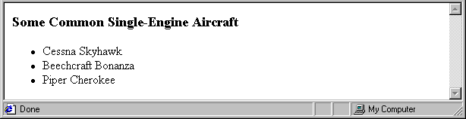
Lists
Unordered lists
The list is the content of the <ul> tag
List elements are the content of the <li> tag
<h3> Some Common Single-Engine Aircraft </h3>
<ul>
<li> Cessna Skyhawk </li>
<li> Beechcraft Bonanza </li>
<li> Piper Cherokee </li>
</ul>

Slide 43
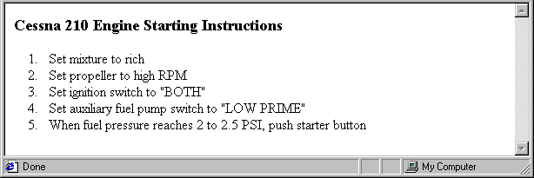
Lists (continued)
Ordered lists
The list is the content of the <ol> tag
Each item in the display is preceded by a sequence value
Nested lists
Any type list can be nested inside any type list
The nested list must be in a list item
<h3> Cessna 210 Engine Starting Instructions
</h3>
<ol>
<li> Set mixture to rich </li>
<li> Set propeller to high RPM </li>
<li> Set ignition switch to "BOTH" </li>
<li> Set auxiliary fuel pump switch to
"LOW PRIME" </li>
<li> When fuel pressure reaches 2 to 2.5
PSI, push starter button </li>
</ol>

Slide 44
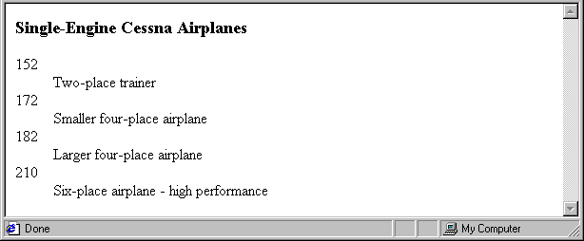
Lists (continued)
Definition lists (for glossaries, etc.)
List is the content of the <dl> tag
Terms being defined are the content of the <dt> tag
The definitions themselves are the content of the <dd> tag
<h3> Single-Engine Cessna Airplanes </h3>
<dl >
<dt> 152 </dt>
<dd> Two-place trainer </dd>
<dt> 172 </dt>
<dd> Smaller four-place airplane </dd>
<dt> 182 </dt>
<dd> Larger four-place airplane </dd>
<dt> 210 </dt>
<dd> Six-place airplane - high performance
</dd>
</dl>

Slide 45
Tables
A table is a matrix of cells, each possibly having content
The cells can include almost any element
Some cells have row or column labels and some have data
A table is specified as the content of a <table> tag
A border attribute in the <table> tag specifies a border between the cells
If border is set to "border", the browser’s default width border is used
The border attribute can be set to a number, which will be the border width
Without the border attribute, the table will have no lines!
Tables are given titles with the <caption> tag, which can immediately follow <table>

Slide 46
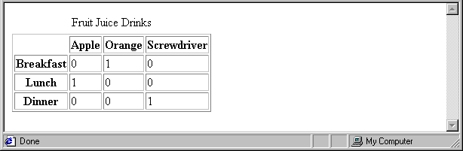
Tables (continued)
Each row of a table is specified as the content of a <tr> tag
The row headings are specified as the content of a <th> tag
The contents of a data cell is specified as the content of a <td> tag
<table border = "border">
<caption> Fruit Juice Drinks </caption>
<tr>
<th> </th>
<th> Apple </th>
<th> Orange </th>
<th> Screwdriver </th>
</tr>
<tr>
<th> Breakfast </th>
<td> 0 </td>
<td> 1 </td>
<td> 0 </td>
</tr>
<tr>
<th> Lunch </th>
<td> 1 </td>
<td> 0 </td>
<td> 0 </td>
</tr>
</table>

Slide 47
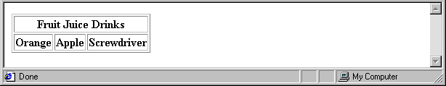
Tables (continued)
A table can have two levels of column labels
If so, the colspan attribute must be set in the <th> tag to specify that the label must span some number of columns
<tr>
<th colspan = "3"> Fruit Juice Drinks </th>
</tr>
<tr>
<th> Orange </th>
<th> Apple </th>
<th> Screwdriver </th>
</tr>

Slide 48
Tables (continued)
If the rows have labels and there is a spanning column label, the upper left corner must be made larger, using rowspan
<table border = "border">
<tr>
<td rowspan = "2"> </td>
<th colspan = "3"> Fruit Juice Drinks
</th>
</tr>
<tr>
<th> Apple </th>
<th> Orange </th>
<th> Screwdriver </th>
</tr>
…
</table>

Slide 49
Tables (continued)
The align attribute controls the horizontal placement of the contents in a table cell
Values are left, right, and center (default)
align is an attribute of <tr>, <th>, and <td> elements
The valign attribute controls the vertical placement of the contents of a table cell
Values are top, bottom, and center (default)
valign is an attribute of <th> and <td> elements
→ SHOW cell_align.html and display it
The cellspacing attribute of <table> is used to specify the distance between cells in a table
The cellpadding attribute of <table> is used to specify the spacing between the content of a cell and the inner walls of the cell

Slide 50
Tables (continued)
<table cellspacing = "50">
<tr>
<td> Colorado is a state of …
</td>
<td> South Dakota is somewhat…
</td>
</tr>
</table>
Table Sections
Header, body, and footer, which are the elements: thead, tbody, and tfoot
If a document has multiple tbody elements, they are separated by thicker horizontal lines

